Slide 1

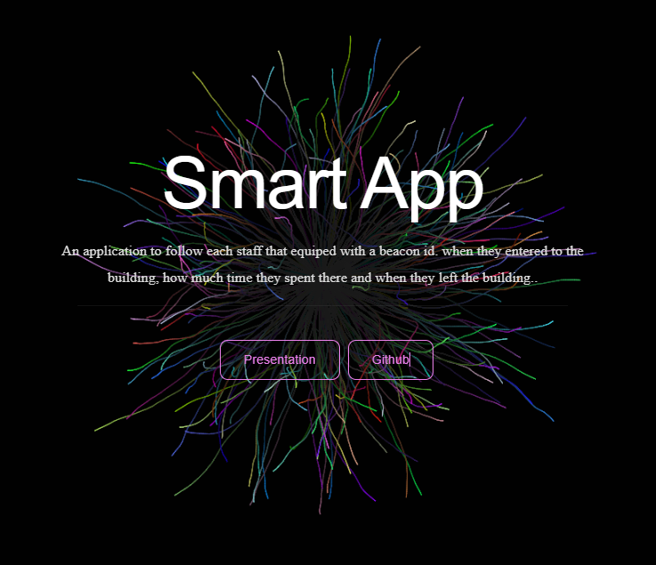
SMART APP iot project
Professors: Davide Ancona
Giorgio Delzanno
Student: Ehsan Eslami Ziraki
(4850649)

Slide 2
Project Outline
Designing a prototype of an indoor contact tracing system to be used to produce an estimation of the number of people inside a building
Implement a prototype of the architecture in Node.js and/or Node-red consisting of the following components:
• Bluetooth emitter simulator
• A Bluetooth scanner installed on devices in specific locations in the building.
• A server that collects data from the scanner, process them in real-time send alarms to users, stores anonymised data and produces statistical data
• A dashboard to visualize anonymised real-time and historical data

Slide 3









Some Tools That Used
MQTT
NodeJS
Express
React
Redux
MongoDB
Mosca Broker
React-Bootstrap
Axios

Slide 4




Project Structure
A scanner: scan based on the floor and the room that specified and send the beaconIDs and other data of the staff to the server by MQTT.
A Server: that receives the data and do the require processes, communicate with the dashboard and store the admin data.
A MongoDB: to store client and server data.
A Dashboard: a landing page and a login section only for admin to see the result and activity log of the staff and do some management.
An Alarm: to notify admin that the room is over crowded!
Dashboard
(React-Redux)
Server
(Mosca-NodeJS)
Scanner
(MQTT Client-NodeJS)
Database
(MongoDB)

Slide 5
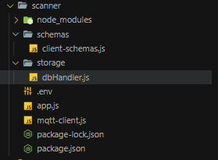
SCANNER
to scan beacon IDs we have :
MQTT Client
MongoDB
NodeJS
Beacon Scanner
When a beacon ID founded, it will subscribe it on the topic that it can be specified through environment variable.
In this project it’s like:
To specify that it belongs to scanner:
/scanner/
To specifity that it belongs to which floor:
floor/
To specify that it blongs to which room:
room/
And finally the beaconID that founded!
beaconid

Slide 6
SCANNER
let mqttClient = function () {
let options = {
port: 1883,
http: { port: 8089, bundle: true, static: './' },
clientId: "/scanner/" + process.env.FLOOR + "/" + process.env.ROOM
};
console.log("mqttClient");
let client = mqtt.connect("mqtt://localhost", options);
client.on("connect", function () {
console.log("mqttClient connect");
});

Slide 7
async function createEmitter(beaconType,uuid_,id_,address,timestamp){
try{ const emitResult = await EmitList.findOne({ uuid: uuid_ })
if (emitResult) {
emitResult.beaconType = beaconType
emitResult.uuid = uuid_
emitResult.id = id_
emitResult.address = address
emitResult.timestamp = timestamp
const result = await emitResult.save()}
else{ const emitResult = new EmitList({
beaconType: beaconType,
uuid: uuid_,
id: id_,
address: address,
timestamp: timestamp,
})
mqttClient.subscribe("/unige/" +process.env.FLOOR +"/"+process.env.ROOM +
"/" + uuid_);
const result = await emitResult.save()
}

Slide 8
users.forEach( function (user) {
if (user.timestamp+3500 < current_time){
var bid = user.toObject().uuid
console.log('user removed')
mqttClient.unsubscribe(
"/unige/" +
process.env.FLOOR +
"/" +
process.env.ROOM +
"/" +
bid
)
user.remove();
}});
}})

Slide 9
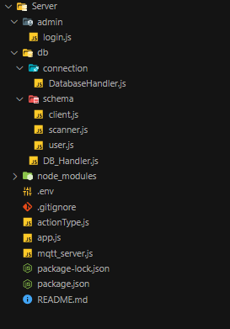
Server
on server we used :
Mosca Broker
MongoDB
NodeJS
Node Mailer
What server does:
Initial the database
Insert admin authentication detail inside the model of users to do login on dashboard.
We subscribe on the topic to get the beaconIDs.
Add/update the beacon IDs to db
We track the number of people inside the room
If the room reached to the maximum send notification will send to the dashboard
Also an email will sent to the users via node mailer
Based on the action type that we get on server we add/update/remove data about the rooms and staff inside the database.

Slide 10
SERVER
export const ADDSTAFF = '/ADDSTAFF’;
case "/ADDSTAFF":
db.addUser(data, (e) => {
if (e == null) {
const topic = "admin/" + client__Id + "/result/success";
server.publish({topic: topic,
payload: JSON.stringify({ result: "done" }),
});
} else {
const topic = "admin/" + client__Id + "/result/fail";
server.publish({topic: topic,
payload: JSON.stringify({ result: "fail" }),
});
}
});
break;

Slide 11
SERVER
server.on("subscribed", function (topic, client) {
let floor = topic.split("/")[2];
let room = topic.split("/")[3];
let clientId = topic.split("/")[4];
let timeIn = Date.now();
const topic = "update/room";
const answer = {
count: res,
room: room,
floor: floor,
};
server.publish({
topic: topic,
payload: JSON.stringify({ type: "roomCount", result: answer }),
});

Slide 12
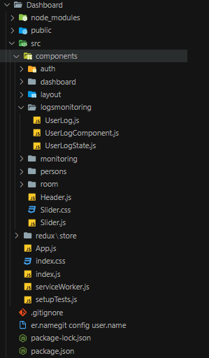
Dashboard
On dashboard we used :
React-Redux
React-Bootstrap
React-Vis
Axios
What dashboard does:
On landing-page, some info and login form to authenticate.
With MQTT Middleware we handle MQTT actions required.
With Axios we do the authentication of admin.
On Admin Dashboard we have LiveView to show the chart of who is currently joined the room and who left. Admin can track the number of people inside the room and total capacity of the room. And also it has an activity log button to download a txt file of the activity to record the activity logs on local machine.
Admin can add staff with specific beacon ID
Admin can add room on specific scanner and floor and room number.
Admin can see the list of all registered staff and room and staff inside the room.

Slide 13
Dashboard
<BrowserRouter>
<Switch>
<Route path='/' exact component={Header}/>
<Route path='/dashboard' exact component={Dashboard}/>
<Route path='/room/:floor/:room' component={RoomDetail}/>
<Route path='/signin' component={SignedIn}/>
<Route path='/signup' component={Signedup}/>
<Route path='/addroom' component={AddRoom}/>
<Route path='/roomstatus' exact component={RoomStatus}/>
<Route path='/addstaff' component={AddStaff}/>
<Route path='/person' exact component={Persons}/>
<Route path='/person/:floor/:room' component={Persons}/>
</Switch>
</BrowserRouter>

Slide 14
Dashboard
Store:
const persistedReducer = persistReducer(persistConfig, rootReducer);
const middlewarea = composeWithDevTools(
applyMiddleware(thunk, middleware("http://127.0.0.1:3002"))
);
const store = createStore(persistedReducer, middlewarea);

Slide 15
Dashboard
Middleware:
case actionType.ADDSTAFF:
client.publish(
"command/" + clientId + "/s",
JSON.stringify(action.payload)
);
break;
Reducer:
case actionType.ADDSTAFF:
return {
...action.person,
};
Action:
export const addStaff = data => ({
type:action.ADDSTAFF,
payload:data
})

Slide 16
Dashboard
Middleware:
case actionType.ADDSTAFF:
client.publish(
"command/" + clientId + "/s",
JSON.stringify(action.payload)
);
break;
Reducer:
case actionType.ADDSTAFF:
return {
...action.person,
};
Action:
export const addStaff = data => ({
type:action.ADDSTAFF,
payload:data
})

Slide 17
Dashboard
const persistedReducer = persistReducer(persistConfig, rootReducer);
const middlewarea = composeWithDevTools(
applyMiddleware(thunk, middleware("http://127.0.0.1:3002"))
);
const store = createStore(persistedReducer, middlewarea);

Slide 18
Dashboard
class AddStaff extends Component {
state = {
type: actionType.ADDSTAFF,
name: "",
surename: "",
email: "",
password: "",
beaconid: "",
}; handleChange = (e) => {
this.setState({
[e.target.id]: e.target.value,
});
};
<input type="text" placeholder="Name" id="name" onChange={this.handleChange} />

Slide 19
Dashboard
Dispatch Mapper
const mapDispatchToProps = (dispatch) => {
return {
addStaff: (person) => dispatch(addStaff(person)),
resetResult: () => dispatch(resetResult()),
};
};
State Mapper
const mapStateToProps = (state) => {
return {
result: state.result.result,
loginData: state.auth.login,
};
};

Slide 20
Dashboard
Download User Activity Log:
const element = document.createElement("a");
const file = new Blob([event.target.textContent],
{type: 'text/plain;charset=utf-8'});
element.href = URL.createObjectURL(file);
element.download = "activityLog.txt";
document.body.appendChild(element);
element.click();

Slide 21
Notification On Dashboard
<h6 className="inactive" style={{color:"#ddf704"}}>
_______________ Room is full now _______________ </h6>

Slide 22
Notification On Server
let transporter = nodemailer.createTransport({
host: 'smtp.gmail.com',
port: 587,
secure: false,
requireTLS: true,
auth: {
user: ’AdminEmail',
pass: ’AdminPass'
}
}); var mailOptions = {
from: ’AdminEmail',
to: ’UsersEmails',
subject: 'Sending Email using Node.js',
text: 'Room is FULL!'
};

